Slide 1
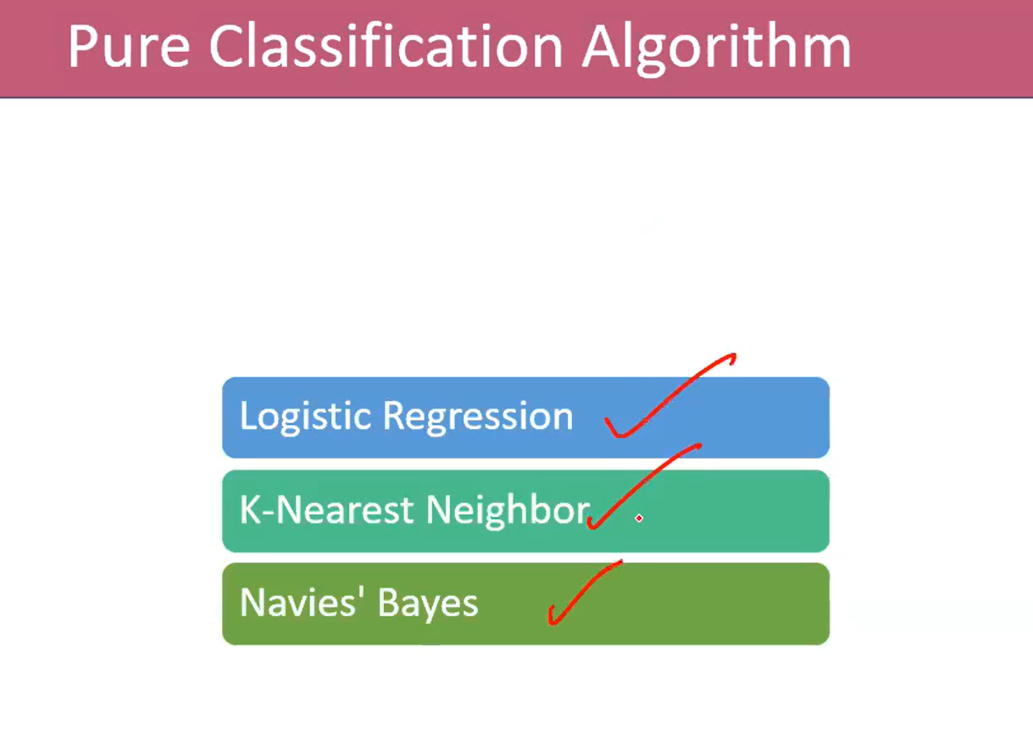

Slide 2
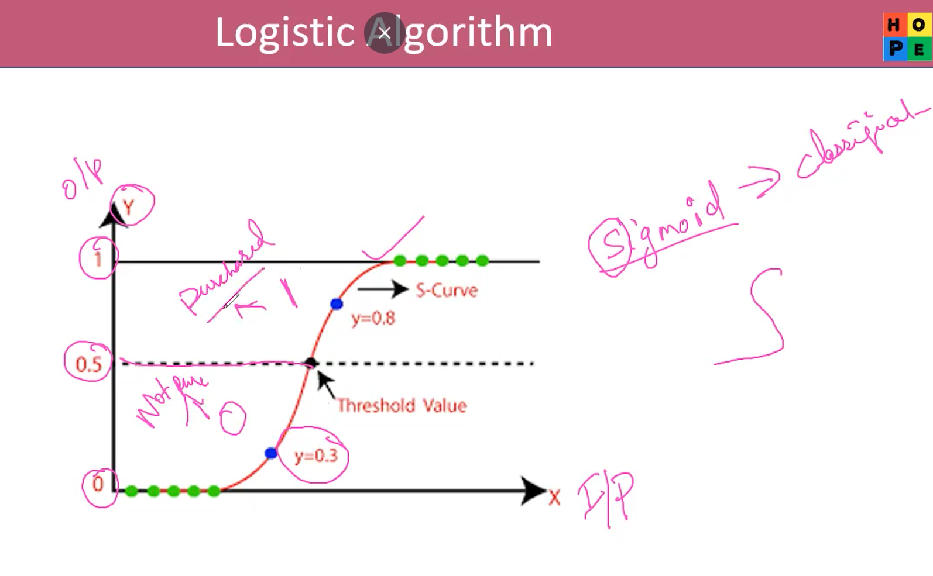
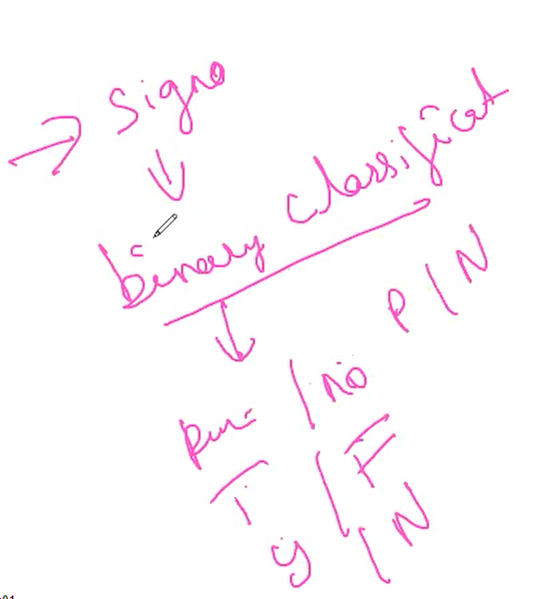

Slide 3
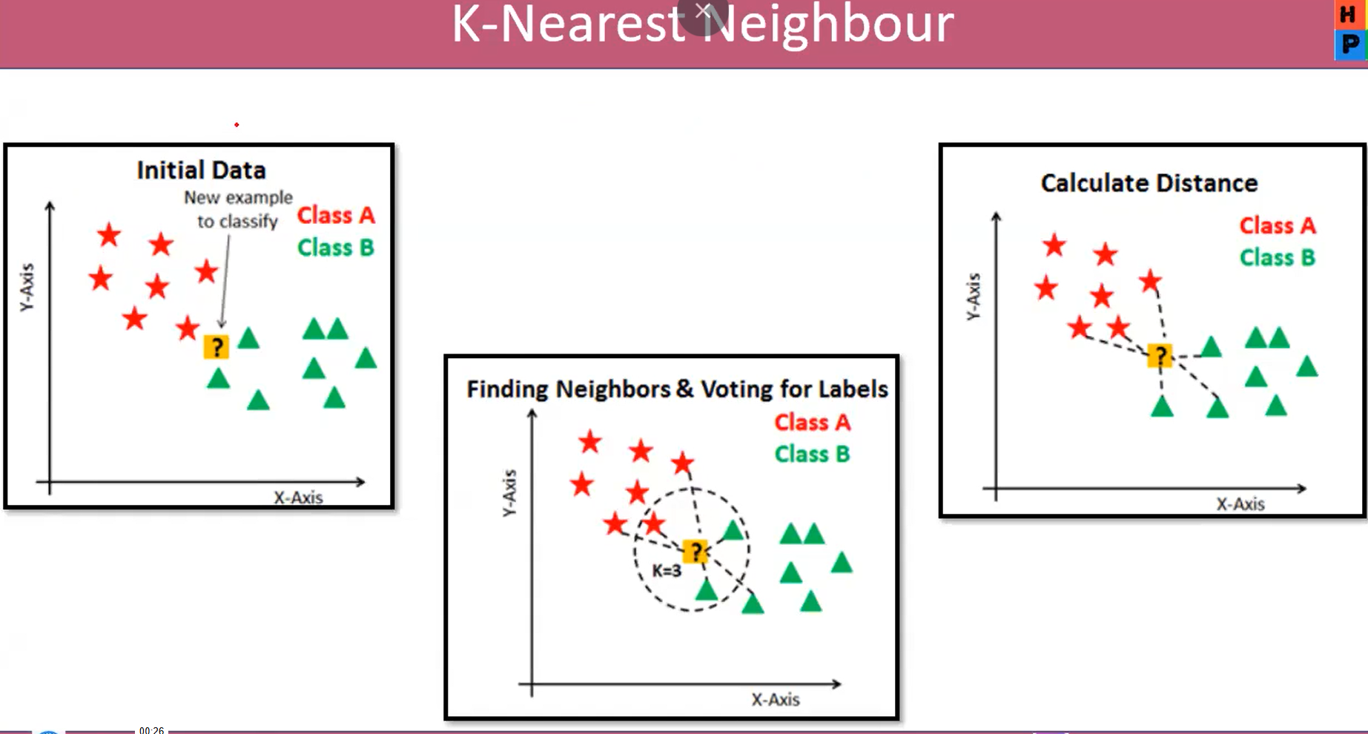

Slide 4
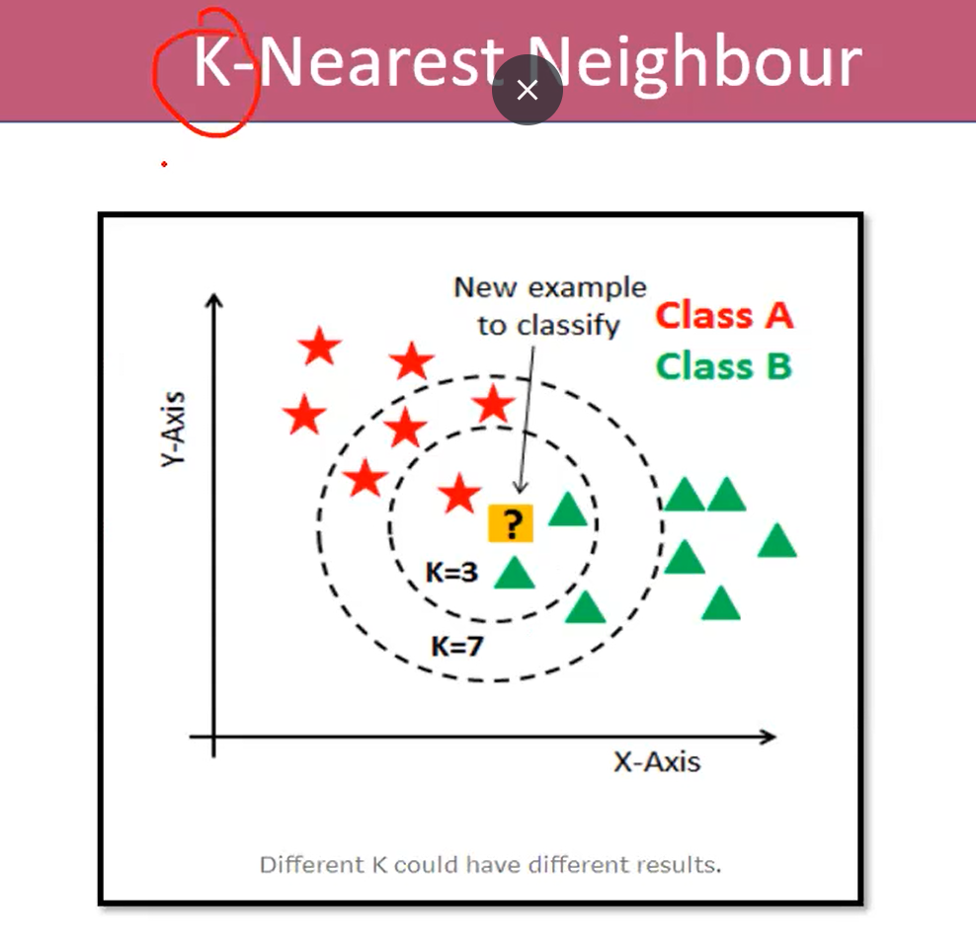

Slide 5
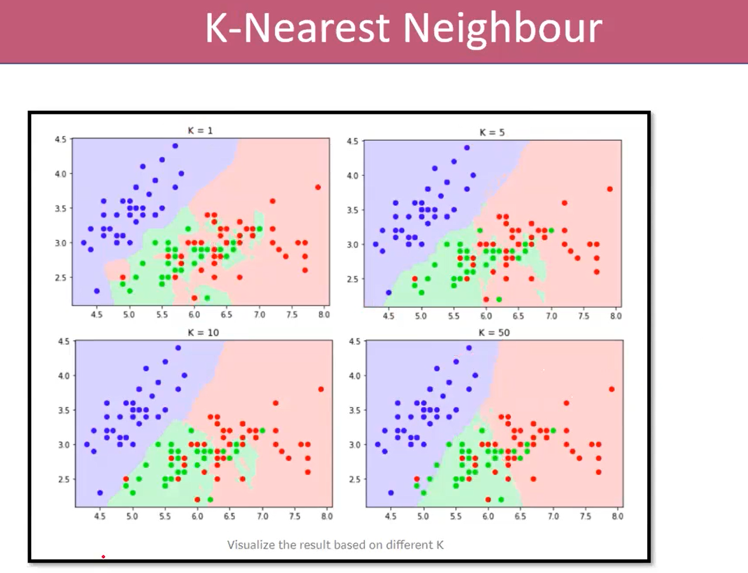

Slide 6
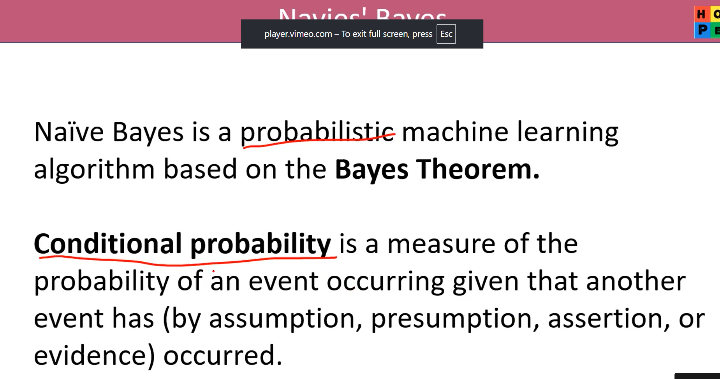

Slide 7
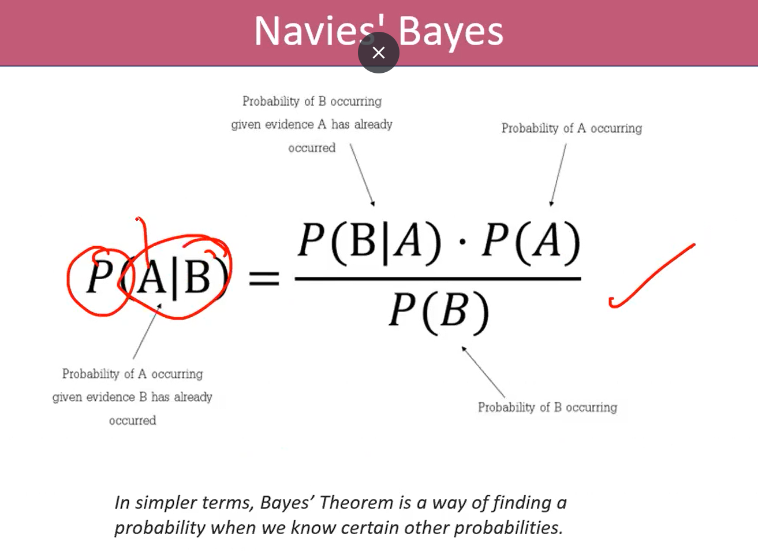

Slide 8
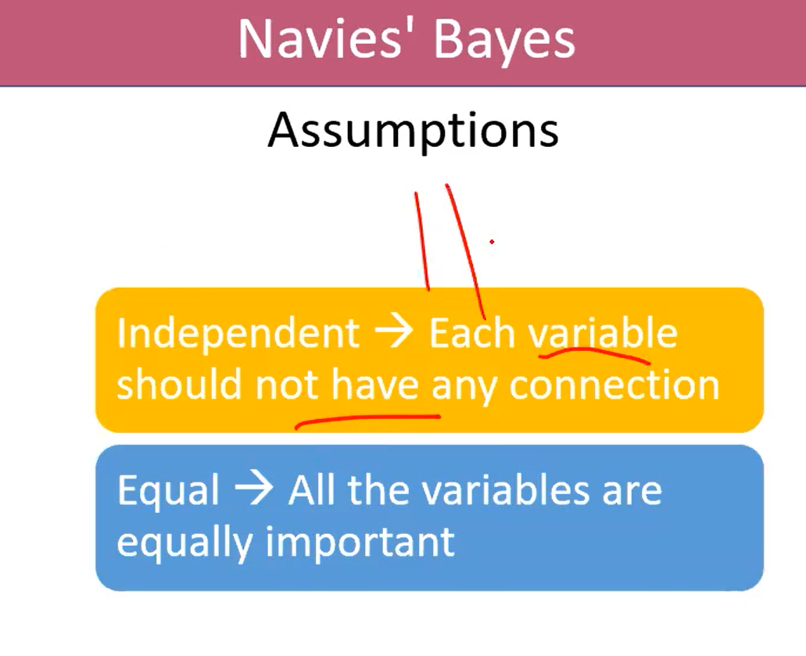

Slide 9
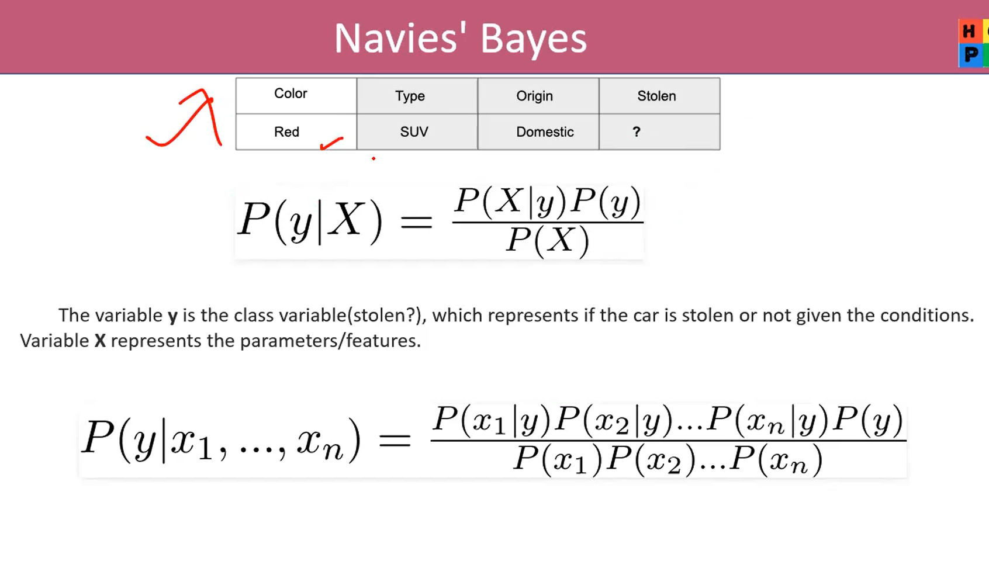

Slide 10
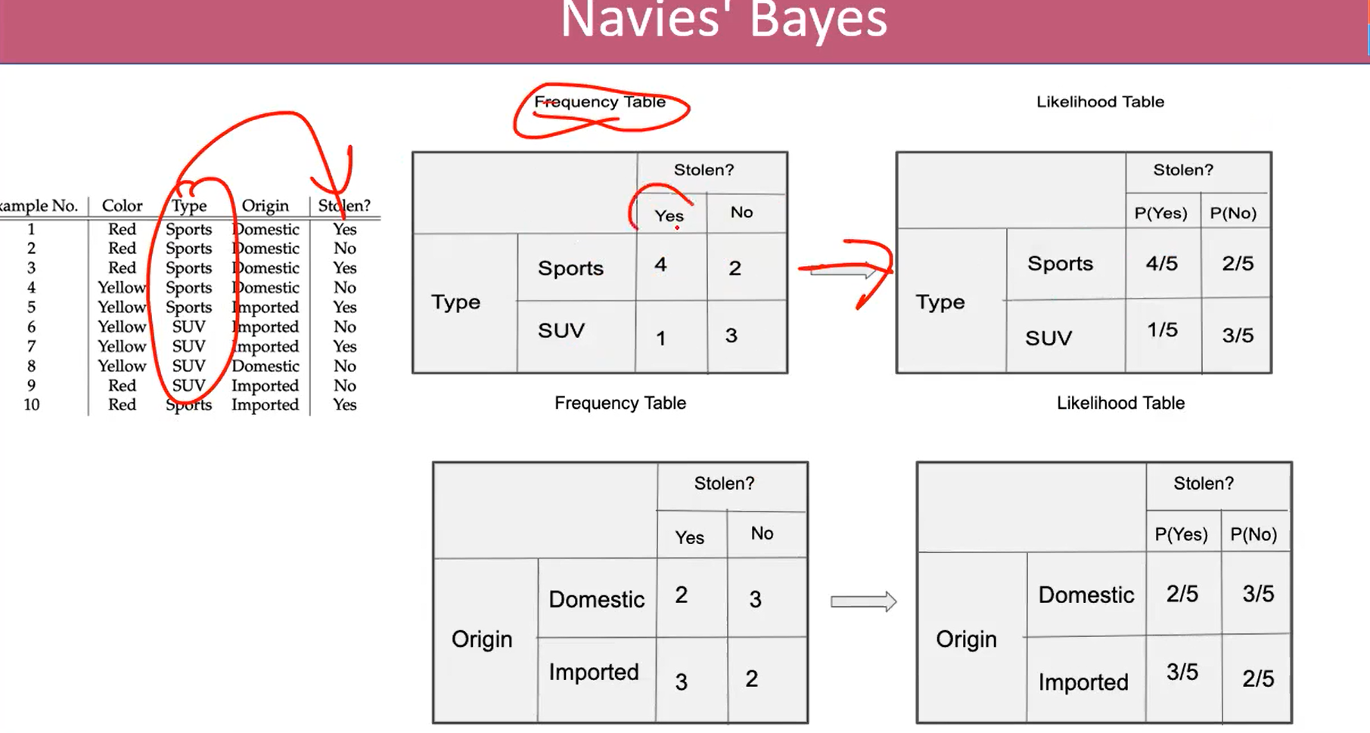
 |  | Stoten?
 |  | P(yes) | P(no)
Color | Red | 3/5 | 2/5
 | Yellow | 2/5 | 3/5

Slide 11
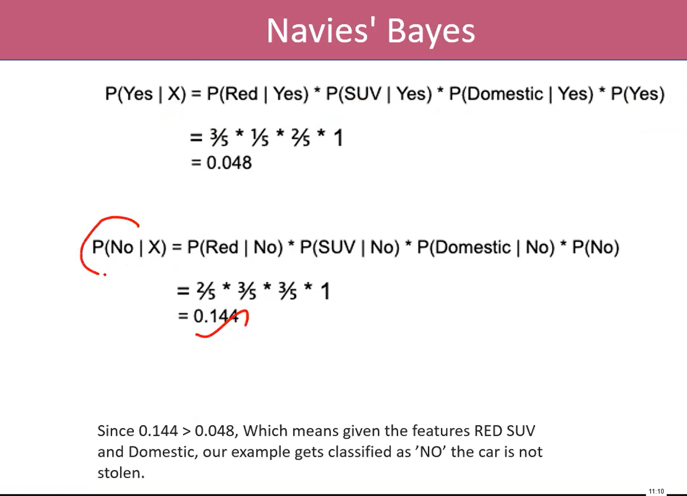
 |  | Stoten?
 |  | P(yes) | P(no)
Color | Red | 3/5 | 2/5
 | Yellow | 2/5 | 3/5

Slide 12
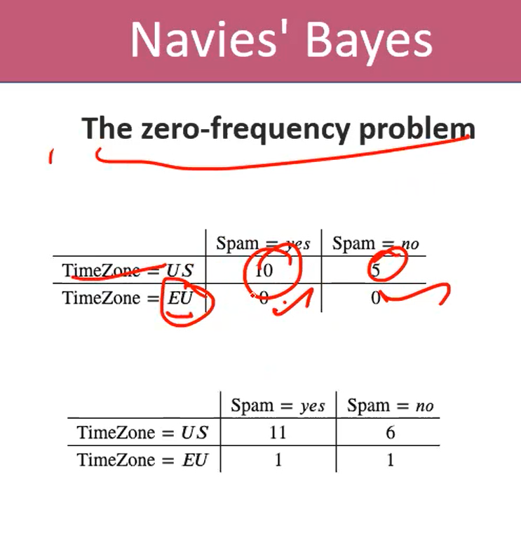
Add 1 for avoid zero frequency

